Slide 1
Digital Portfolio
STUDENT NAME: J.Hemamaalini
REGISTER NO AND NMID:222402529 And asunm161222402529
DEPARTMENT: Computer Science
COLLEGE: Prince Shri Venkateswara Arts and Science College/Madras University

Slide 2
PROJECT TITLE
Digital Portfolio using Front end Web development

Slide 3


AGENDA
Problem Statement
Project Overview
End Users
Tools and Technologies
Portfolio design and Layout
Features and Functionality
Results and Screenshots
Conclusion
Github Link
3/21/2024 Annual Review

Slide 4

PROBLEM STATEMENT
In today’s competitive academic and professional environment, individuals need a strong online presence to showcase their skills, achievements, and experiences. Traditional resumes and printed portfolios often fail to highlight creativity, interactivity, and real-time accessibility.
There is a need for a responsive, visually appealing, and user-friendly digital portfolio website that allows individuals to present their personal details, education, projects, certifications, and contact information in an organized manner. The portfolio should be easily accessible across devices
In today’s competitive academic and professional environment, individuals need a strong online presence to showcase their skills, achievements, and experiences. Traditional resumes and printed portfolios often fail to highlight creativity, interactivity, and real-time accessibility.
There is a need for a responsive, visually appealing, and user-friendly digital portfolio website that allows individuals to present their personal details, education, projects, certifications, and contact information in an organized manner. The portfolio should be easily accessible across devices (desktop, tablet, mobile) and highlight both design skills (UI/UX) and technical implementation (HTML, CSS, JavaScript, frameworks).
The challenge is to design and develop a personal digital portfolio website that:
Provides a structured representation of personal and professional information.
Showcases projects, skills, and achievements interactively.
Ensures responsiveness and accessibility across all devices.
Allows easy updates and scalability for future growth.

Slide 5

PROJECT OVERVIEW
The Digital Portfolio Website is a personal web-based platform designed to showcase an individual’s professional and academic achievements in an interactive and visually appealing manner. With the increasing importance of online presence, this project aims to replace traditional resumes with a dynamic, responsive, and engaging portfolio that highlights skills, projects, certifications, and experiences.
The website will be developed using frontend technologies such as HTML, CSS, and JavaScript

Slide 6

WHO ARE THE END USERS?
The end users of the digital portfolio website include both the creator and the audience who access it. The primary end user is the portfolio owner, such as a student, job seeker, or professional, who uses the platform to present their personal details, skills, projects, and achievements in a structured way. On the other hand, the secondary end users are the viewers of the portfolio, which include recruiters and employers who evaluate candidates during hiring, academic faculty who assess project submissions, and potential clients or collaborators

Slide 7

TOOLS AND TECHNIQUES
This project uses HTML (HyperText Markup Language) for structuring the content of the portfolio, CSS (Cascading Style Sheets) for designing and styling the web pages, and JS (JavaScript) for adding interactivity and dynamic features. For responsive design, frameworks like Bootstrap may be used, and for enhanced user experience, React.js (React JavaScript Library) can be applied.
The development is carried out using VS Code (Visual Studio Code) as the code editor, while Git (Global Information Tracker) and GitHub are used for version control and deployment.

Slide 8
POTFOLIO DESIGN AND LAYOUT
The portfolio has a clean and responsive design. The Home page shows the name and introduction. The About Me section gives personal details and career goals. The Skills section highlights technical and soft skills. The Projects section displays completed works with links. The Achievements section shows awards and certifications. The Resume section allows CV download. The Contact section provides a form and social links. A simple navigation bar connects all sections, and the layout is designed for both desktop and mobile users.
8

Slide 9
FEATURES AND FUNCTIONALITY
The portfolio is responsive and works on all devices.
It has a Home page with introduction.
The About section shows personal details.
The Skills section highlights abilities.
The Projects section displays work with links.
The Achievements section shows awards and certificates.
A Resume download option is available.
The Contact section has a form and social links.
Navigation is smooth and interactive.
The site loads fast and is easy to update.

Slide 10
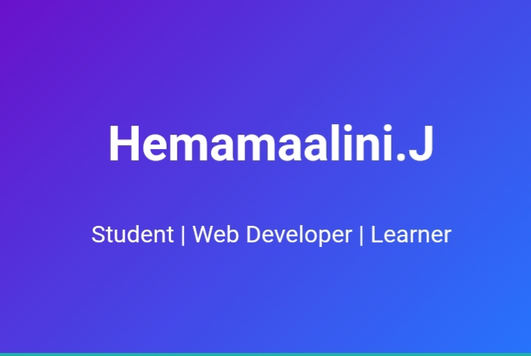

RESULTS AND SCREENSHOTS
3/21/2024 Annual Review
10

Slide 11
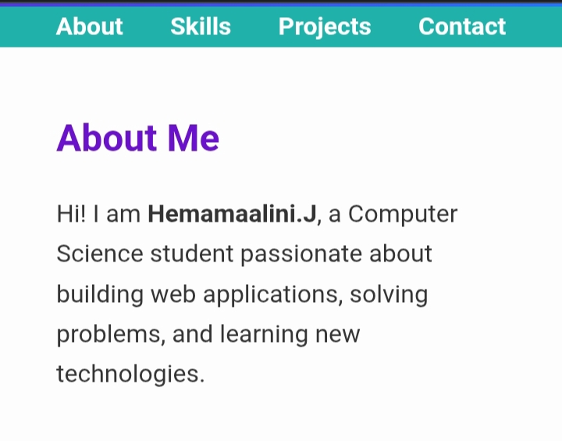

Slide 12
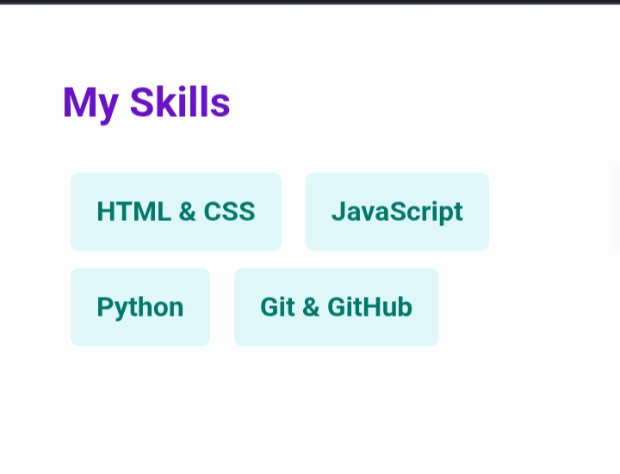

Slide 13
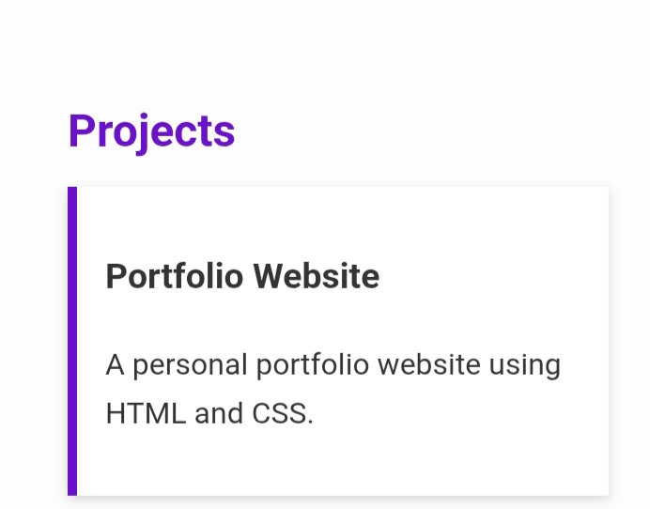

Slide 14
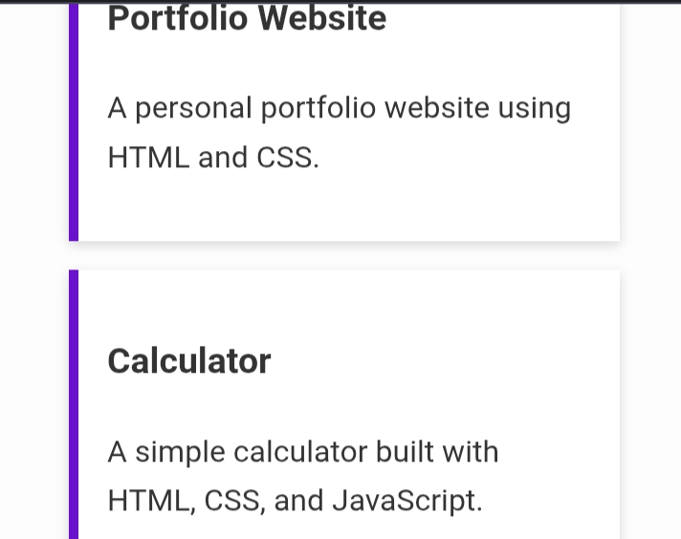

Slide 15
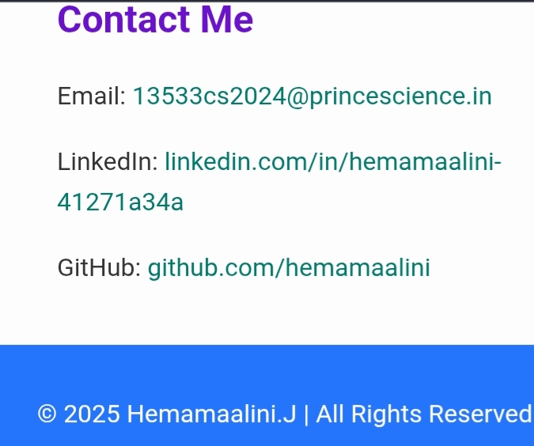

Slide 16
CONCLUSION
The digital portfolio is a modern way to showcase personal and professional details.
It highlights skills, projects, and achievements in an organized manner.
The design is responsive and user-friendly on all devices.
It helps students, professionals, and freelancers build a strong online presence.
The project improves web development skills using HTML, CSS, and JavaScript.
Overall, the portfolio serves as a professional identity and career tool.
16

